Slide 1
Using a Recovery Key to Access Your Mac
Document Version 1.0

Slide 2
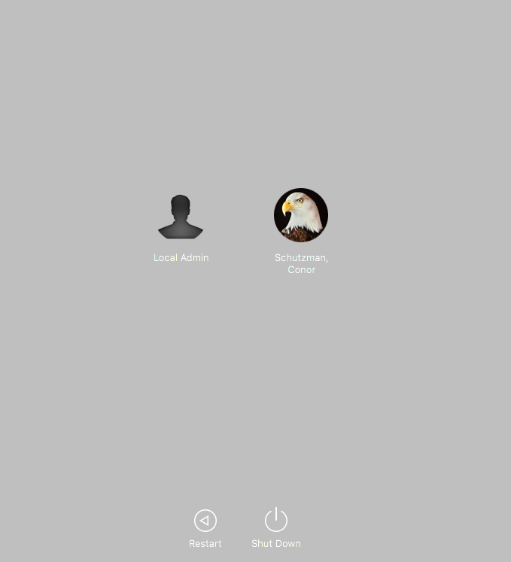
Unlock screen
One of the easiest ways to confirm that FileVault is enabled is the initial screen visible after boot up. TE managed devices without FileVault enabled will have a log in screen with a user name and password field for user’s to enter their network credentials. With FileVault enabled, this screen is instead an unlock screen with icons for every admin account that has approved to unlock the device.

Slide 3
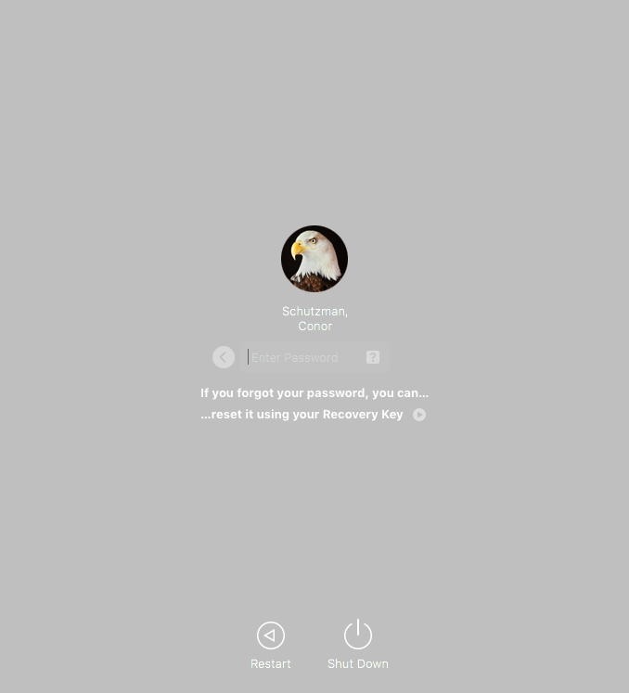
Acquire Recovery Key
Contact TEIS Support, they can use internal tools to retrieve your device’s recovery key. This is a 24-digit alpha-numeric string, made up of 6 groups of 4 characters.
Restart your Mac.
On the unlock screen, click on your AD account, click on the Help button (?). Any password hint you entered is displayed, as well as a button to reset your password using a Recovery Key.

Slide 4
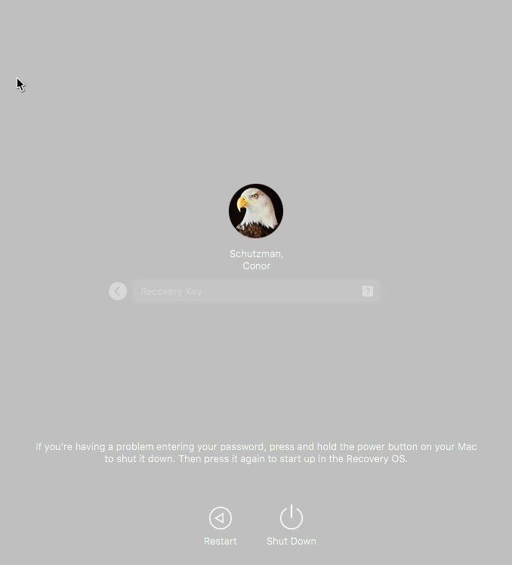
Enter Recovery Key
Using the space provided, enter the recovery key you have been provided. All letters will be automatically capitalized for you, and hyphens will be automatically added between blocks of characters. Press Return when you have finished entering the key.

Slide 5

Allow Log In to Complete
A semi-normal boot up process will then commence. Note that this particular login may take slightly longer than is typical.
You will be presented with a progress bar to illustrate the state of the log in process.

Slide 6
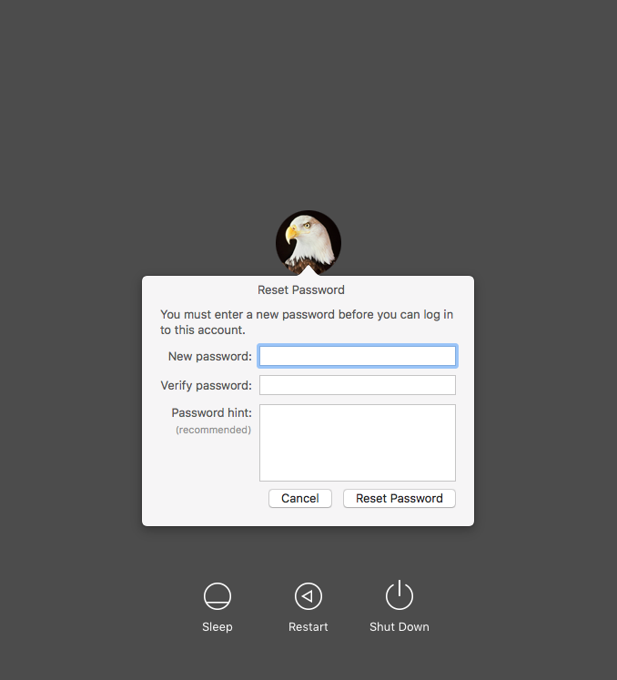
Reset Password
As the log in completes, you will be prompted to change your password.
If you are on the TE network, this will also change your AD password. If you are not on the TE network, this change will be cached, and the system will attempt to change your AD password upon your next connection to the AD network. If your new password doesn’t meet those requirements, your machine password will revert to your current AD password.

